Slide 1


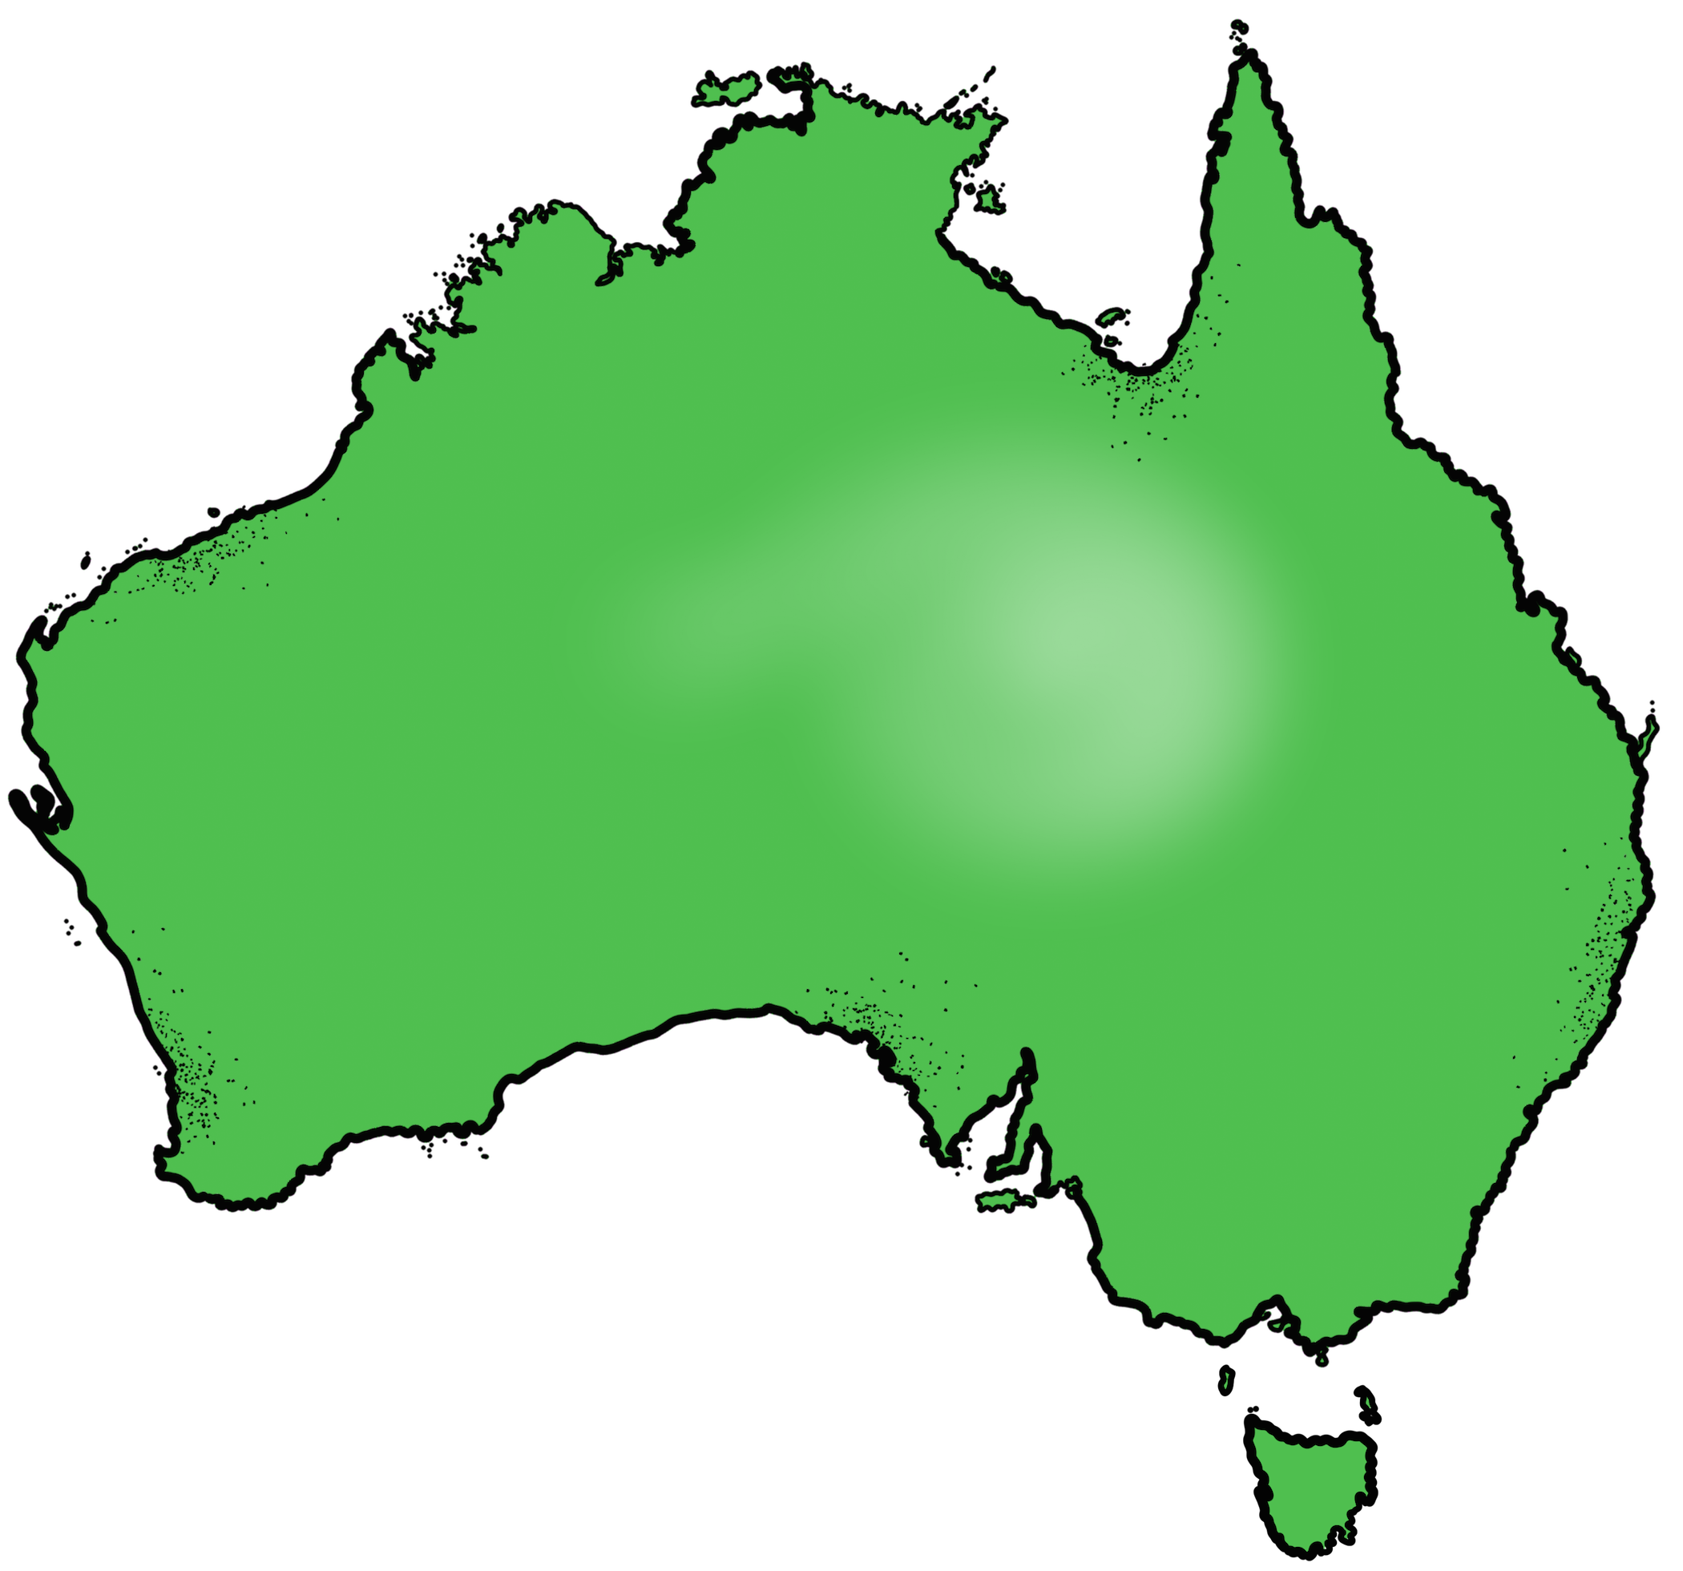
Australian curriculum – Civics and citizenship

Slide 2
Statutory law
Learning objective: Identify and describe how statutory laws are made.

Slide 3
Parliament
Government
Cabinet
The law-making body consisting of all members of both houses, from all parties, plus the Crown’s representative. The Commonwealth parliament’s structure is the governor general, the senate and the House Of Representatives.
The government is the political party that holds a majority in the lower house of parliament. All members of the parliament who belong to this political party form the government. The other major party that did not win the election forms the opposition.
The policy-making body made up of the prime minister and senior government ministers who have been placed in charge of a government department. It decides which laws should be introduced into parliament.
Learning objective: Identify and describe how statutory laws are made.

Slide 4
Statute law – Law made by parliament, also known as legislation.
Law- making is the main role of parliament. A proposed law is a bill. A bill must pass through both houses of parliament and receive royal assent before it can become an act.
CFU:
What is a statue law?
Before a bill can become an act what needs to happen?
Vocabulary:
Statue law – law made by parliament.
Assent - agreement
Learning objective: Identify and describe how statutory laws are made.

Slide 5
Different types of bills
Bills can be:
Government bills - the majority of bills are introduced in parliament by the relevant minister on behalf of the government. For example, the minister for health introducing a bill concerning health issues. Government bills have been formulated by cabinet as part of its program to implement government policy.
Vocabulary:
Cabinet – the policy making body of government, made up of the prime minister and senior ministers.
Formulated- create or prepare methodically.
Implement - put (a decision, plan, agreement, etc.) into effect.
CFU: Pair share (Complete sentences)
What is a government bill?
Learning objective: Identify and describe how statutory laws are made.

Slide 6
Appropriation bills (also known as money bills or supply bills) – These bills are also government bills. They authorise the government to spend the money collected through taxation and other means. These bills can only be introduced in the lower house.
CFU: Pair/share
Where do appropriation bills get introduced?
What are Appropriation bills? What do they authorise?
Vocabulary:
Authorise – allow
Learning objective: Identify and describe how statutory laws are made.

Slide 7
Health Care (Appropriation) Amendment Bill 2002
This Bill seeks to introduce two changes to the Health Care (Appropriation) Act 1998 (‘the Act’). The first proposed change will increase the maximum amount of financial assistance that the Minister for Health and Ageing may grant to the States and Territories under the Australian Health Care Agreements. The second proposed change will require the Minister for Health and Ageing to table a statement of the amount of financial assistance granted under the new maximum payment level.
Vocabulary:
An appropriation is an amount of money that a government or organization reserves for a particular purpose.
CFU:
What was changed to this bill?
Who is affected by this change?

Slide 8
Private bills- A private bill is very rare. It is introduced by the government and only applies to one person or one group.
The Community Protection Act 1990(Vic.) was a private bill that only applied to a prisoner named Garry David. He was a prisoner who made wild and dangerous threats such as threatening to blow up the MCG on grand final day. This act was necessary to hold him in prison. Since this time the law has been amended to deal with such violent prisoners in general by introducing indefinite sentencing.
Vocabulary:
Indefinite - lasting for an unknown or unstated length of time.
CFU: Pair/share
What is a private bill?
Who do private bills apply to?
Learning objective: Identify and describe how statutory laws are made.

Slide 9
Private members’ bills- On some occasions an individual member of parliament (not acting on behalf of the government) may wish to introduce a bill that the cabinet has chosen not to include in its legislative program. This is known as a private members’ bill. These bills are often on controversial issues such as abortion and euthanasia. Private members’ bills are generally unsuccessful because they do not have the backing of the cabinet, and, as members of parliament often vote according to the dictates of their political party, such bills may not get sufficient support.
Vocabulary:
Controversial – giving rise or likely to give rise to controversy or public disagreement.
Sufficient - enough; adequate.
CFU: Pair/share
What is a private members’ bill?
Why are they not generally successful?
Learning objective: Identify and describe how statutory laws are made.

Slide 10
Example Private Members bill
Amends the: Marriage Act 1961 to: redefine marriage as ‘a union of two people’; introduce non-gendered language so that the requirements of the Act apply equally to all marriages; enable same-sex marriages that have been, or will be, solemnised under the law of a foreign country to be recognised in Australia;
Vocabulary:
Redefine – define again or differently.
Union – the action of joining together or the fact of being joined together, especially in a political context.
Solemnised – mark (an event) with a formal ceremony
Amend - make minor changes to (a text, piece of legislation, etc.) in order to make it fairer or more accurate, or to reflect changing circumstances.
CFU:
What group of people did this bill affect?
Why was this act amended?

Slide 11
Because parliament is an elected body, it aims to represent the needs of the electorate.
The law needs to keep changing in response to changes in the community and changing values.
A change in the law will often begin with a problem that is not adequately dealt with by the law as it stands.
This leads to demands being made by members of the community for changes in the law.
For example, injury and loss of life on our roads is a constant problem that has been addressed in many ways such as laws against speeding and tailgating. A problem that continues to exist is the large number of fatal crashes that involve P plate drivers.
Adequately –to a satisfactory or acceptable extent.
Electorate - the area represented by one Member of Parliament.
CFU: Pair/share
Why does the law need to keep changing?
Learning objective: Identify and describe how statutory laws are made.

Slide 12
Pressures for change
Many individuals or institutions and groups influence law-makers to change the law. Individuals can express their views to members of parliament or through the media. They can gain the attention of the law-makers by signing petitions, writing to the editors of newspapers, joining a pressure group or being involved in demonstrations.
Institutions – an organization founded for a religious, educational, professional, or social purpose.
Express – convey (a thought or feeling) in words or by gestures and conduct
Petitions - a formal written request, typically one signed by many people, appealing to authority in respect of a particular cause.
CFU:
How can law makers be influenced to change the law?
Learning objective: Identify and describe how statutory laws are made.

Slide 13
Pressures for change
Parliamentary committees may be asked to investigate the need for change in the law and make recommendations to parliament. Government departments also constantly review the laws in operation and the need for changes in the law. For example, the tax department may find loopholes or gaps when processing tax returns and may recommend to parliament that changes in the law be made to close these loopholes.
Loopholes - an ambiguity or inadequacy in the law or a set of rules.
Ambiguity - the quality of being open to more than one interpretation; inexactness.
CFU:
1. What do government departments do?
Learning objective: Identify and describe how statutory laws are made.

Slide 14
Parliamentary committees
To assist in the running of parliamentary business, committees have been set up to investigate a variety of matters and report back to parliament. They consist of members of parliament and are established because parliament does not have the time to carry out its own enquiries into particular aspects of society and the possible needs for changes to the law.
Committees can discuss matters in detail, conduct public enquiries, hear witnesses, and promote public awareness and debate on matters being considered by the parliament.
They are also a method used by the parliament to ascertain the needs of the people. There are three main types of committees: joint committees, standing committees and select committees.
CFU: Pair/share
What are the three types of committees?
Why have these committees been set up?
Ascertain - find (something) out for certain; make sure of.
Learning objective: Identify and describe how statutory laws are made.

Slide 15
Role of cabinet and ministers
Cabinet decides on which laws need to be changed. To do this they have extensive resources to find out what laws need to be changed or what new laws need to be developed.
The cabinet is very influential on bills that are passed through parliament. This is particularly the case when the government holds majority in both house, as bills that are proposed by cabinet will receive the support of the majority of members in both houses.
The cabinet and the prime minister are not mentioned in the Constitution, but are conventions inherited from England. At a state level the premier is the head of the cabinet.
Extensive – covering or affecting a large area
Influential – having great influence on someone or something.
Inherited -to receive as if by succession from predecessors
CFU: Pair/share
What is the role of cabinet?
Learning objective: Identify and describe how statutory laws are made.

Slide 16
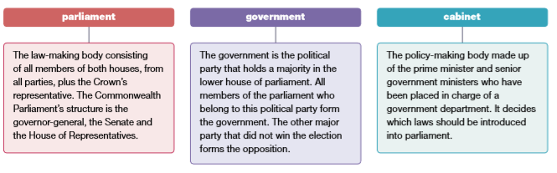
Learning objective: Identify and describe how statutory laws are made.

Slide 17
Ministers are responsible for government departments. It is their role to find out what changes in the law may be required in their field of responsibility. If a department feels a change in the law is necessary it will advise its minister who, if in agreement with the proposal, will ask for cabinet approval.
If the minister is not a member of the cabinet (for example, the minister for science), the minister will contact a member of cabinet to have the proposal brought to the notice of cabinet. The relevant minister will usually introduce the bill to parliament.
CFU:
What does the minister do?
Advise – recommend
Proposal – a plan or suggestion, especially a formal or written one, put forward for consideration by others.
Relevant - closely connected or appropriate to what is being done or considered.
Learning objective: Identify and describe how statutory laws are made.

Slide 18
Drafting legislation
A parliamentary counsel is a lawyer who has responsibility for drafting legislation and who is given instructions from cabinet about the purpose and extent of the proposed legislation.
Cabinet formulates the policy proposal. In the case of a Labor Government, the relevant committee is also consulted about the proposal.
CFU:
Who drafts legislation?
Who formulates the proposal?
Extent – the particular degree to which something is or is believed to be the case.
Consulted - seek information or advice from (someone, especially an expert or professional).
Learning objective: Identify and describe how statutory laws are made.

Slide 19
The parliamentary counsel’s role is too:
Examine and analyse the instructions given by cabinet
Examine the constitutional, legal and other implications of the policy
Discuss the proposals with the relevant government departments
Decide how the policies can be implemented
Prepare a draft bill
Send the draft bill to the relevant government department for consideration
Send copies of the draft to others
Ensure that legislation is legally effective, that is, does what it is intended to do.
Vocabulary:
Examine – Inspect thoroughly
Analyse – examine closely
Implications –
the conclusion that can be drawn from something although it is not explicitly stated.
Proposals – a plan or suggestion, especially a formal or written one, put forward for consideration by others.
Consideration – careful thought, typically over a period of time.
CFU:
1. What do you think is the most important role of the parliamentary counsel?
Learning objective: Identify and describe how statutory laws are made.

Slide 20
Process of a bill through parliament
A bill may be introduced in either the upper or the lower house except those bills that give the government the authority to raise taxes or spend money. These bills must be introduced into the lower house, which is a tradition inherited from England. More bills are introduced in the lower house because about three-quarters of ministers sit in the lower house.
CFU:
What two bills are not introduced in the upper or lower house?
Authority – the power or right to give orders, make decisions, and enforce obedience.
Inherited - derive (a quality, characteristic, or predisposition) genetically from one's parents or ancestors.
Learning objective: Identify and describe how statutory laws are made.

Slide 21
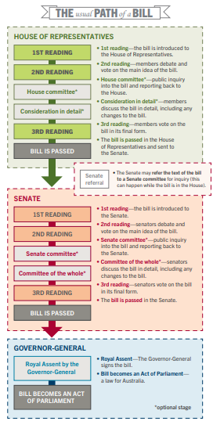
House of representatives:
First reading
2nd reading
House committee
Consideration in detail
3rd reading
Bill is passed.
Senate:
1st reading
2nd reading
Senate committee
Committee of the whole
3rd reading
Bill is passed
Governor-General:
Royal assent by the Governor-General
Bill becomes an act of parliament.
Learning objective: Identify and describe how statutory laws are made.

Slide 22
Restrictions on law-making by parliament
There are however, restrictions on parliaments’ ability to make laws. Some of these are shown below.
Conflicting views within the community
Economic viability
Public debate
Constitutional restrictions
A hostile upper house
Outdated legislation
Lack of time
Vocabulary:
Viability – the capacity to operate or be sustained
Hostile – showing or feeling opposition or dislike; unfriendly.
CFU:
What are some of the restrictions parliaments have on making laws?
Learning objective: Identify and describe how statutory laws are made.

